Slide 1
Case Studies

Slide 2


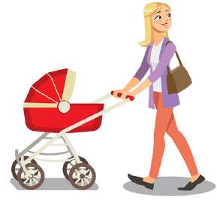
A Family

Slide 3
A Family (contd.)

Slide 4


Problem Statement
Hi, Honey
Why didn’t you answer immediately
I was in a meeting
Ok.. You always give some excuse. Anyway, I have sent mails see it!!!!
RING … Ring … Ring

Slide 5
Problem statement 1
We need a E-Stroller:
Mommy wheels the baby out
Sometimes she is not in a position to push it so we need some assistance
Sometimes going sown the slope the stroller pulls her and she is likely to fall
Sometimes she has to handle it with one hand as she is taking her knitting bag.
I am worried that somebody will lift the baby when granny is busy knitting
She also needs some assistance while steering the stroller.

Slide 6
Problem statement 2
Automatic Parking:
You know I am always in a hurry to catch their flights
I don’t have time to search for a parking space in the parking lot
You know I am paranoid of somebody else driving the car
Design an automatic parking system for our Mercedes you know it is a drive by wire car.

Slide 7
Problem statement 3
Automatic Medicine Dispenser
You know Papa and Mamma have amnesia
They keep forgetting to take their pills regularly.
Sometimes they get confused and interchange each others medicines
They need to get prescriptions for refill automatically from the doctor and the doctor also needs to know if they are taking their medicines properly
I also need to be kept updated on their consumption of medicines.

Slide 8
Super Engineer
Super Engineer develops solutions for all three problem statements

Slide 9
Group Conceptualization Activity
Three Groups of students to develop a solution at least for one of the problem statements and present it in the class.
Time allocated for this activity: 30 minutes for design and 15 minutes for presentation.

Slide 10
E-Stroller Requirements
Assist in moving up or down the slopes
Assist in steering
One handed operation
Safety: Unattended, Battery condition, ECU Health etc.
Security
Remote Monitoring
Environmental Monitoring

Slide 11
E-Stroller Sensors & Actuators
DC – Motors Compact : Independent Drive
Pressure Sensors on the Handle Bar – Sense attended operation & intention of Turning.
Emergency Brakes
Path condition sensing to control drive speed
Weight Sensing to detect presence of child
Built in Self Tests
GPS --- To know the location of the stroller at any time
Authorizing Persons
Communication – With Smart Devices nearby
Environmental Monitoring: Temperature, Humidity, UV sensor etc….

Slide 12
E-Stroller : Possible Architecture
Temperature Sensor
ECU
Speaker
PSU
Handle Bar Pressure Sensor + Vibrator
Brake
GPS
Drive Motors with Controller
Accelerometer
Load Sensor
Bluetooth &
LD-Com
LED Status Indicators
UV sensor

Slide 13

E-Stroller
Smartphone APP:
Authentication
Health monitoring of the Stroller
Environmental Parameters
Emergency operation
Communication with Remote Phone / Monitoring Device
Movement Tracking
Good Weather

Slide 14
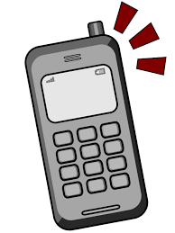
E-Stroller
Kidnap
Smartphone APP:
Authentication
Health monitoring of the Stroller
Environmental Parameters
Emergency operation
Communication with Remote Phone / Monitoring Device
Movement Tracking

Slide 15
BOSCH - E-Stroller
Smartphone connection to the eStroller system via Bluetooth
Convenient app-based control of the assist level and alarm function
Useful information about the battery status and remaining range
Electric push assist on uphill and downhill stretches and on rough terrain
Automatic motor brake activates when the user lets go of the handlebar
Automatic parking brake is applied when the user parks the stroller

Slide 16
BOSCH - E-Stroller
Two electric motors help with acceleration and braking
Comfort and safety are the key criteria for nine out of ten parents when buying a stroller.
The system’s drive unit comprises two low-noise electric motors on the rear axle.
Bluetooth module and a smart sensor system.
The sensors measure things like the stroller’s speed and acceleration while assessing the road surface it is moving over.
On an uphill path, the motors automatically help push the stroller. When on a downhill slope, Motors help to brake.
Unattended stroller: Motor brake prevents it from rolling away unchecked, and the electromechanical lock engages the parking brake.
The system’s steering support also brings clear benefits when pushing with just one hand.

Slide 17
BOSCH - E-Stroller
Smartphone connectivity via Bluetooth
App on the Smart phone allows: Users choose from three levels of electric assistance using the associated smartphone app
It also displays the charge level of the detachable battery and warns users in good time that power is running out.
The app can be used to activate the alarm function, too, a warning will appear if anyone unauthorized tries to push the stroller away.
In addition, an alarm will sound from the stroller’s integrated loudspeaker and the parking brake will automatically reengage.

Slide 18
BOSCH - E-Stroller
https://www.bosch-mobility-solutions.com/en/products-and-services/micro-mobility/estroller-system/

Slide 19
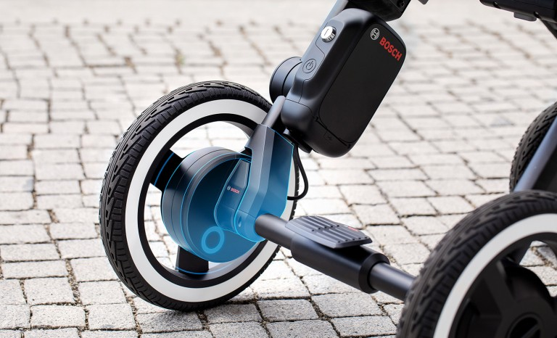
BOSCH - E-Stroller Drive Unit
Drive unit
Two silent
Motors
LED Status Indicator
Bluetooth Module

Slide 20
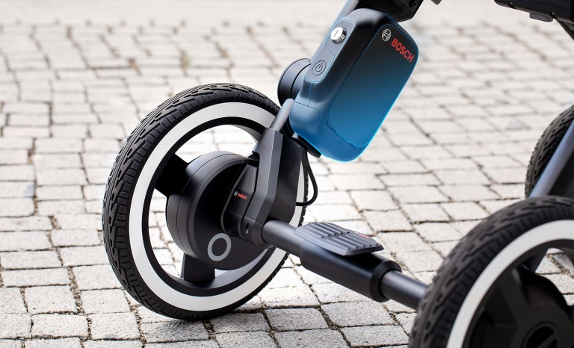
BOSCH - E-Stroller Battery
Batteries:
Li-Ion Batteries Sealed;
Battery level sensors

Slide 21
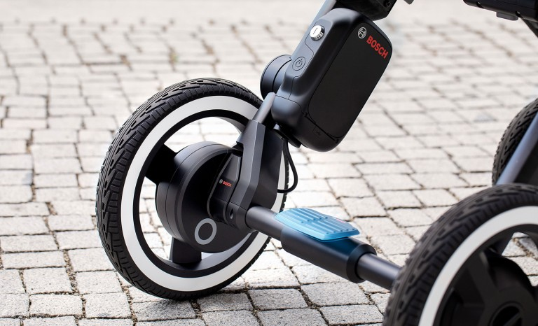
E-Stroller: Safety & Security
Electromechanical Locking:
Parking
Unauthorized Person Pushing

Slide 22
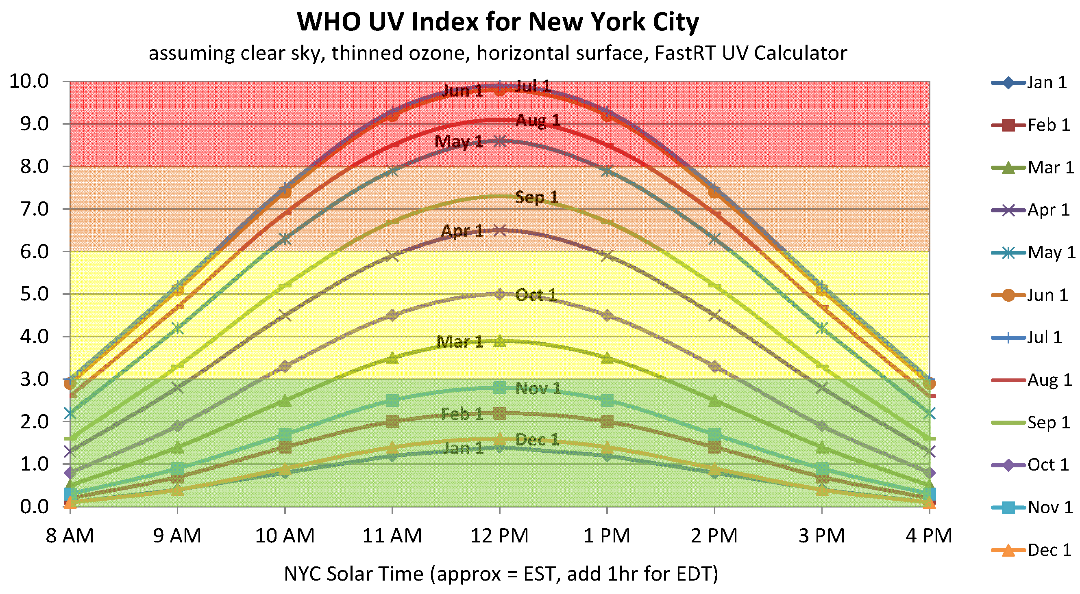
UV – Levels

Slide 23

BOSCH - E-Stroller : Tracking
Track the movements of the E-Stroller—
Specially useful if you have a baby sitter who is taking out the child for a stroll.
Monitor the distance moved
The time spent
Whether the hood was open or closed
Whether the Child was exposed to bright sun-light for a long time. Etc.
More reasons for you to worry about.
UV rad level: 3.001

Slide 24
BOSCH - E-Stroller : Tracking
Age | UV Limit
< 12 mo | 3.0
Older | ……
Track the movements of the E-Stroller—
Specially useful if you have a baby sitter who is taking out the child for a stroll.
Monitor the distance moved
The time spent
Whether the hood was open or closed
Whether the Child was exposed to bright sun-light for a long time. Etc.
More reasons for you to worry about.

Slide 25

BOSCH - E-Stroller : Tracking
Honey do something!!!!!
Baby is being exposed to UV radiation
Track the movements of the E-Stroller—
Specially useful if you have a baby sitter who is taking out the child for a stroll.
Monitor the distance moved
The time spent
Whether the hood was open or closed
Whether the Child was exposed to bright sun-light for a long time. Etc.
More reasons for you to worry about.

Slide 26
Automatic Valet Parking in a Parking Lot
Assume: Airport Parking Lot as the scenario.
Generally people arrive late at the airport and are in a hurry to park and catch the flight.
The parking lot decides to offer a service that will allow people to bring their car to a designated entrance of the parking lot and they will take care of the parking.

Slide 27
AVP: Conceptual BD
Steering Control
ECU
Speaker
PSU
Drive Control
Light Control
GPS
Sonar / Lidar
Brake Control
Bluetooth &
LD-Com
LED Status Indicators
Radar sensor

Slide 28
AVP: App
Smartphone App:
Reserving a parking slot & time
On arrival informing the Plot server to park the vehicle
Get an Ack
Request for retrieval of Vehicle
Request for status of the Vehicle i.e Parking Slot number once parked
Additional Services if any.

Slide 29
BOSCH – Solutions Smart City
https://youtu.be/BxXRelFfKWQ
https://www.youtube.com/watch?v=0q-kLX5ISZA&feature=youtu.be
https://www.bosch-mobility-solutions.com/en/products-and-services/mobility-services/connected-parking/community-based-parking/
https://www.youtube.com/watch?v=QjhZ8Das-VI

Slide 30
Geriatric Care
One of the Key Issues in Geriatric Care:
Medicines not being taken at the prescribed time
Amnesia & Dementia
Patients afflicted with Arthritis – Difficult to open bottles
Patients become tired of taking medicines – Tuberculosis.
Caregivers are not given the right picture
Even in Hospitals --- Patients deceive the Care-givers

Slide 31
Non-Adherence to prescribed drug regime
Forgetting to take the drug
Not understanding or misinterpreting the instructions
Experiencing side effects (the treatment may be perceived as worse than the disorder)
Finding the drug to taste or smell bad
Finding restrictions while taking the drug to be inconvenient (for example, having to avoid sunlight, alcohol, or milk products)
Having to take the drug very frequently or follow complicated instructions
Denying the disorder (repressing the diagnosis or its significance)
Believing that the drug cannot help or is not needed

Slide 32
Non-Adherence to prescribed drug regime (contd.)
Mistakenly believing that the disorder has been sufficiently treated (for example, thinking an infection is over just because the fever disappears) Fearing dependence on the drug Worrying about the expense Not caring (being apathetic) about getting better Encountering obstacles (for example, having difficulty swallowing tablets or capsules, having problems opening bottles, or being unable to obtain the drug) Distrusting the health care practitioner

Slide 33
Consequence of Non-adherence
Not adhering is estimated to result in 125,000 deaths due to cardiovascular disease (such as heart attack and stroke) each year. C
Increase of about 23% of nursing home admissions,
Increase of about 10% of hospital admissions
Increase in the frequency of visits by doctors
Phenomenal increase in diagnostic tests
Health Care System Costs shoot up by about $200 billion annually in USA alone
Unnecessary treatment can be avoided by Adherence

Slide 34
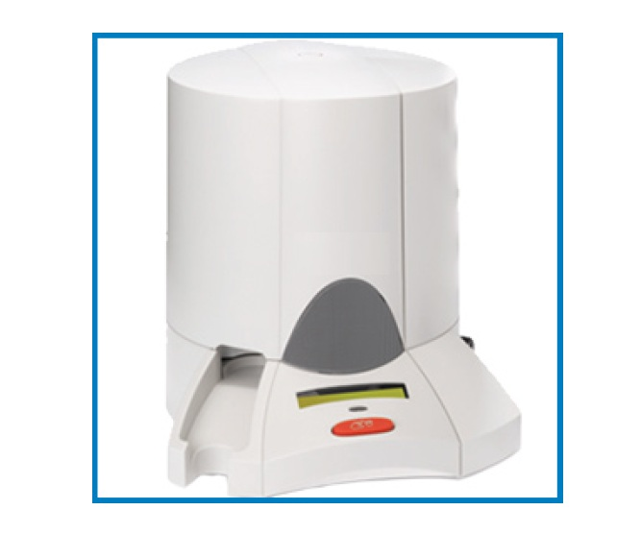
Smart Medicine Dispenser

Slide 35
Objective
To build a Configurable Integrated Pill & Liquid dispenser
Minimal Feature Set
Preloaded cartridges of liquid medicine
Preloaded Compartments with Pills
Dispense based on pre-loaded medication schedule
Issue Reminders & Alarms to Patients & CareGIVERs

Slide 36
Objectives (contd.)
Desirable features
Braille Readout
Display Name & dosage of the Medicine being dispensed
Bar-code Reader to ensure correctness of loading
Synchronizing with doctor’s office for prescription verification
Identification of Patient: Finger print / facial recognition
Detection of low stock level & issue of replenishment requests automatically
Remote Control & Gesture Recognition
Capturing Video of Medicine being actually ingested.

Slide 37
Requirements
Integrating Pill & Liquid Dispenser
Gesture Recognition to control the operation
Authentication in case of a Multiuser
Verification during Medicine Loading
Configurable based on User Requirements
Recording Ingestion of Medicines to establish Compliance
Download Prescription from Doctor’s office
Automatic ordering for Replenishment
Uploading record of Medicine Ingestion
Braille Read Out device

Slide 38
Technology Issues
Design with very few movable parts
Hardware & Software Interlocks.
Reliable Gesture recognition – Hand Gestures / Baton
Remote Control
Fail Safe Design – Access to Medicines in case system fails.
Modular Electronics, Software and Mechanical design for easy Maintenance and Upgradability
Low Power Consumption (Battery operated)

Slide 39
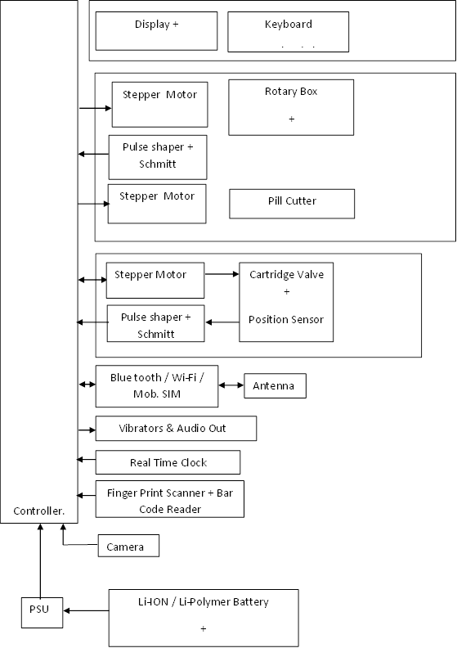
Proposed Solution: HW configuration

Slide 40
Control Software (simplest Configuration)
Support for programming the medication regime.
Based on RTC(Real Time Clock) & Medication Schedule position appropriate Pill compartments / Liquid Cartridge on the Exit Port
Intimation to User
Opening the Exit Port
Acquiring Feedback for ensuring proper operation.
Fail safe operation: SW & HW.

Slide 41
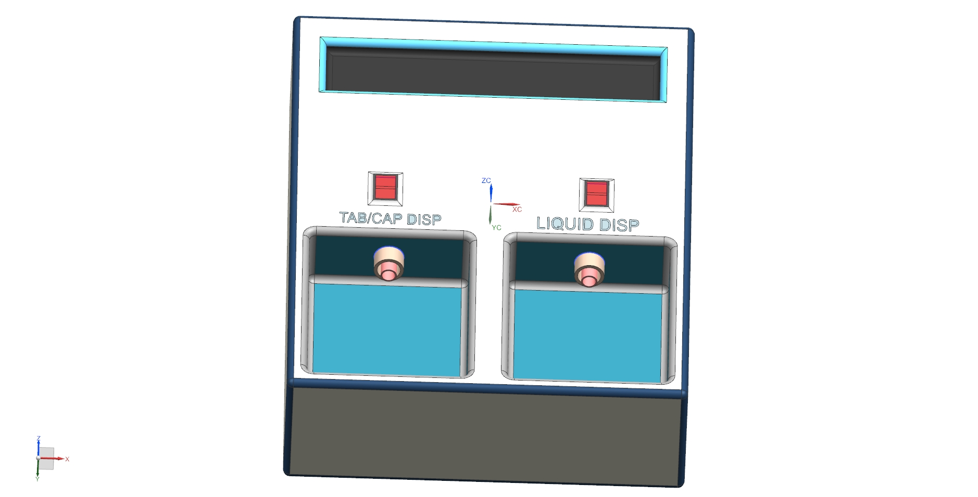
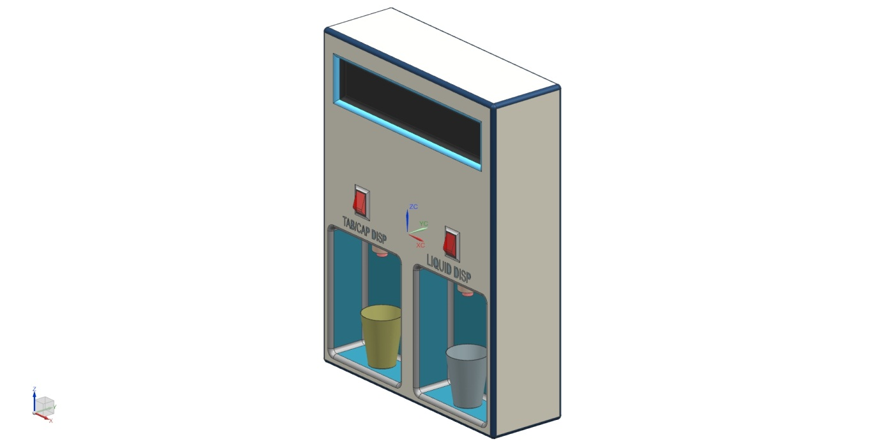
Artistic Impression

Slide 42
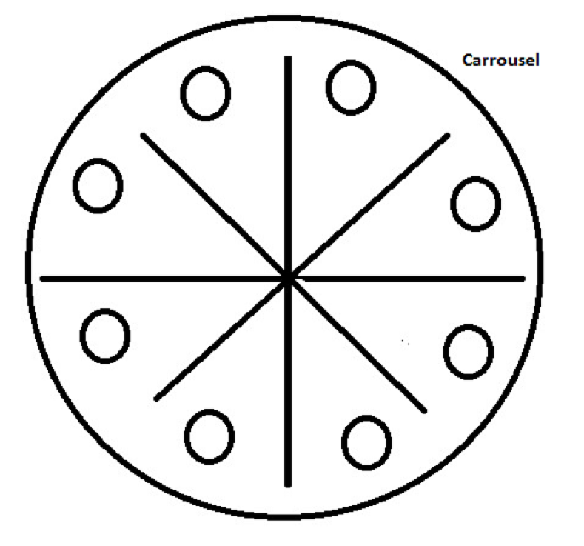
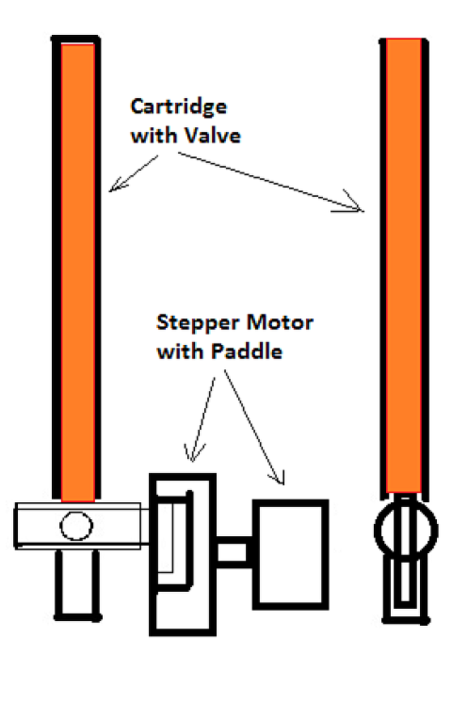
Artistic Impression: Liquid Dispenser

Slide 43

Cheaters – Out of Desperation
Even with all these technologies built into the dispenser the Elderly can still Cheat the system. -- Spitting out the pills and the syrups away from the FOV of the camera.
Why me!!!!

Slide 44
Cheaters – Out of Desperation
Even with all these technologies built into the dispenser the Elderly can still Cheat the system. -- Spitting out the pills and the syrups away from the FOV of the camera.
Why me!!!!

Slide 45
Ingestible Sensors
Ingestible Event Markers
Proteus

Slide 46
Overview of the System

Slide 47
IEM -- Embedding
IEM:
: Size of a grain sand
: Non-toxic.
: Digestible
NOTE:
NO POWER SOURCE

Slide 48
Proteus Personal Monitor

Slide 49
Working Principle
IEM: Before it is embedded into the capsule / tablet is given an UID depending on the drug– chemical composition
When the capsule or tablet is ingested
The stomach fluids and the Electrolyte coating on the IEM form a bio-galvanic power source -- Battery.
IEM – Depending on the ID programmed into it modulates the current drawn from the Battery source.
This results in an Electric field that propagates through the body tissues to the skin.
This is picked up by the PPM --- Decoded, time stamped and stored
PPM – Also collects data from other body sensors and time stamps and logs them.
When the PPM detects the presence of the Registered Mobile in the proximity, It transmits all the logged data to the phone.
This can in turn transfer the data through the cloud to the Caregivers, hospital, doctors etc.

Slide 50
Proteus Personal Monitor

